Slide 1
CND212: Digital Testing and Verification

Slide 2
Configuration Database

Slide 3
Component Configuration
A configurable testbench provides a degree of freedom to the verification engineer
UVM has an internal database table in which we can store values under a given name
Provided information can be retrieved later in various parts of the testbench
uvm_config_db is a mechanism for defining component configurations
It is structured for hierarchical configurations.
Focused on component instances
Can be used globally

Slide 4
Component Configuration
Mechanism for configuring object properties

Slide 5
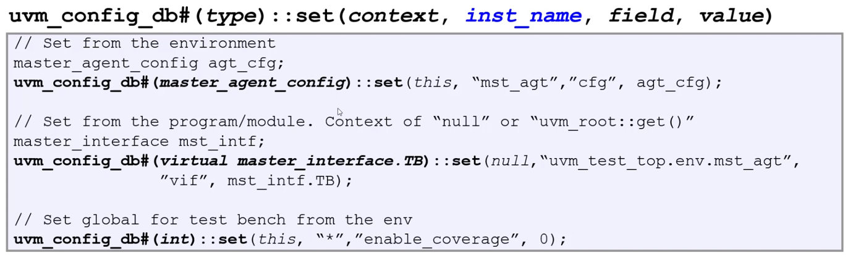
Component Configuration: set
Full-Hierarchy-Path to UVM Object | Field | Value
uvm_test_top.env.mst_agt | cfg | agt_cfg
uvm_test_top.env.mst_agt | vif | mst_intf.TB
uvm_test_top.* | enable_coverage | 0

Slide 6
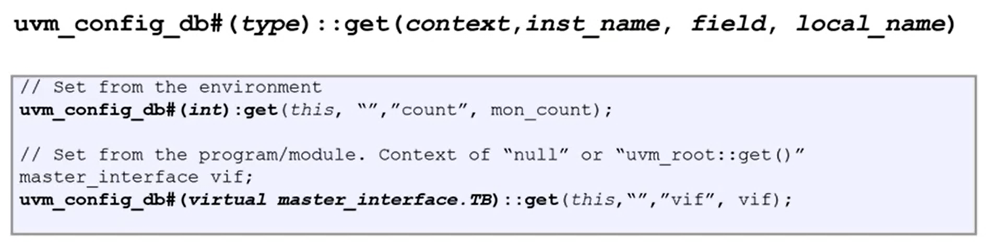
Component Configuration: get

Slide 7
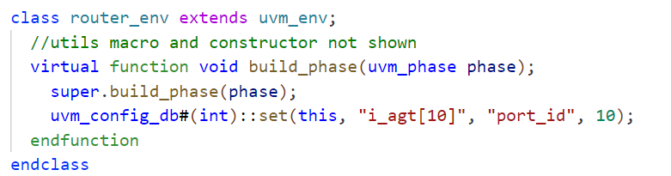
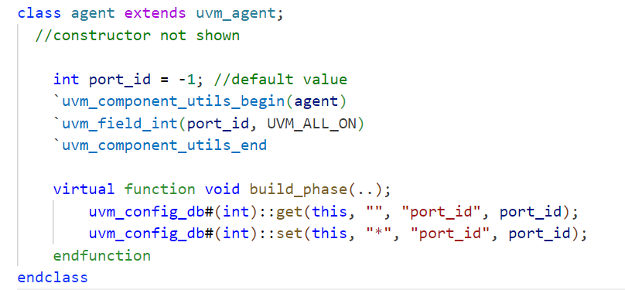
Configuring a Component Interface
Notes:
Setting and configuring an agent interface in the environment
Agent then configures its child components

Slide 8
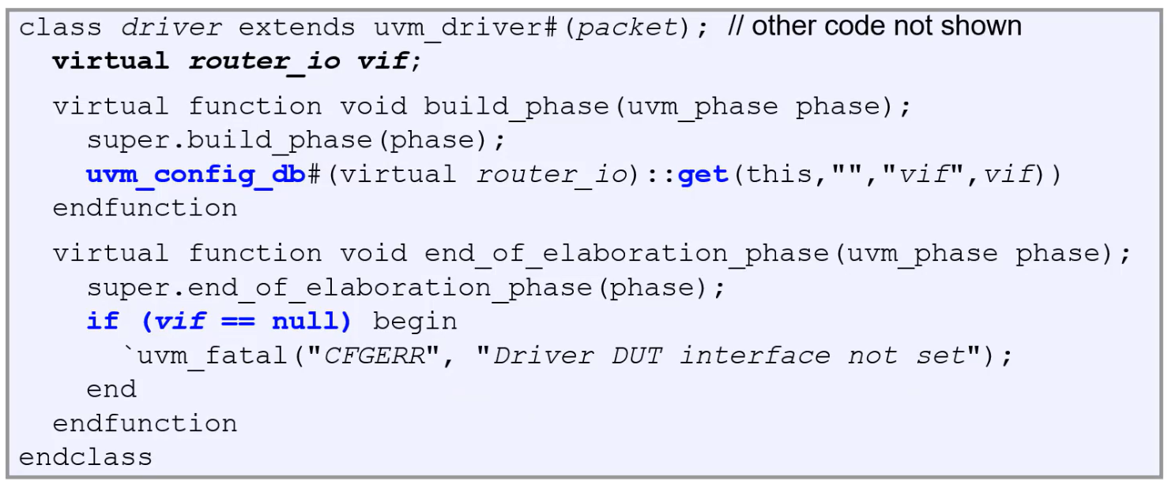
Configuring a Component Interface
In driver/monitor
Call uvm_config_db#()::get() in build_phase
Check for correctness in end_of_elaboration_phase

Slide 9
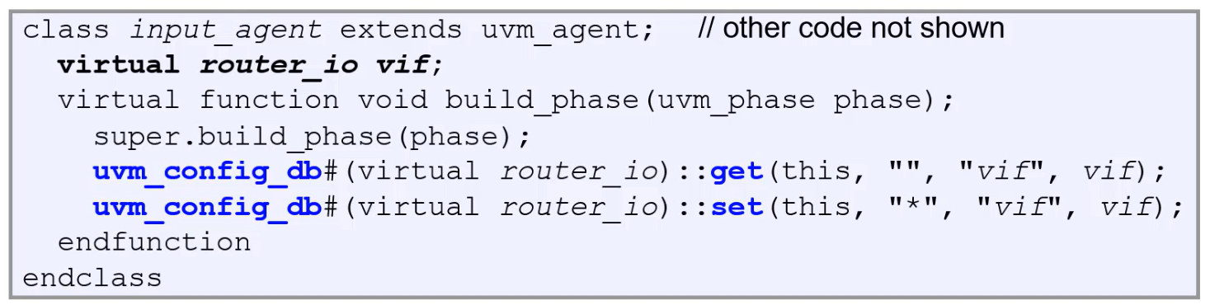
Configuring a Component Interface
In agent
Call uvm_config_db#()::get() in build_phase to retrieve interface
Call uvm_config_db#()::set() in build_phase to set interface for children of agent

Slide 10
UVM Factory

Slide 11
Why do we need Factory?
UVM factory gives a mechanism to improve the flexibility, scalability, and reusability of the testbench
Factor allows the user to substitute an existing class object with any of its inherited child class objects.
User can use the “factory overriding” feature given by UVM to swap instances of an old class with instances of a new class.
Each user-defined class needs to be registered in the factory.

Slide 12
Factories in UVM
Factory registration
`uvm_object_utils (Type)
`uvm_component_utils (Type)
Construct object using static proxy class method
ClassName obj = ClassName::type_id::create(..);
Class overrides
Set_type_override_by_type(…);
Set_inst_override_by_type(…);

Slide 13
How Overriding Happens
A factory can be thought of as a look-up table
The component wrapper class can be accessed using type_id
It is used in create method
Returns a resultant handle
using the polymorphism concept
The factory override mechanism returns a derived type handle using a base type handle.
When the create method is called for the base class type, uvm_factory will return a pointer to an object of a derived class type.

Slide 14
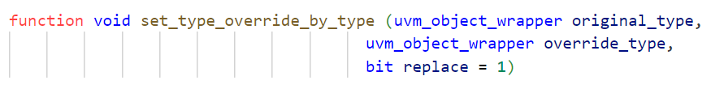
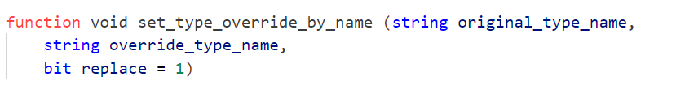
Types of Factory Component Overrides
Type override
In a type override, a substitute component class type is created instead of an original component class in the testbench hierarchy. This applies to all instances of that component type.

Slide 15
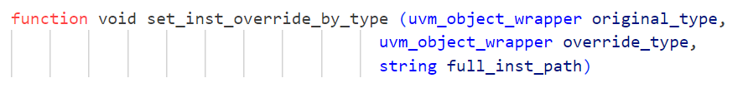
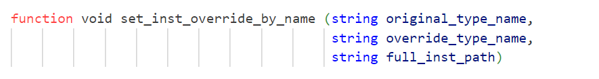
Types of Factory Component Overrides
Instance override
Unlike type override which overrides all instances of the type, instance override overrides only specified positions in the UVM component hierarchy.

Slide 16
Type Override: Example
function void build_phase(uvm_phase phase);
uvm_factory factory = uvm_factory::get();
super.build_phase(phase);
set_type_override_by_type(component_A::get_type(), component_B::get_type());
comp_A = component_A::type_id::create("comp_A", this);
factory.print();
endfunction
function void build_phase(uvm_phase phase);
uvm_factory factory = uvm_factory::get();
super.build_phase(phase);
factory.set_type_override_by_name("component_A", "component_B");
comp_A = component_A::type_id::create("comp_A", this);
factory.print();
endfunction

Slide 17
Type Override: Example
function void build_phase(uvm_phase phase);
uvm_factory factory = uvm_factory::get();
super.build_phase(phase);
component_A::type_id::set_type_override(component_B::get_type());
comp_A = component_A::type_id::create("comp_A", this);
factory.print();
endfunction

Slide 18
Instance Override: Example
function void build_phase(uvm_phase phase);
uvm_factory factory = uvm_factory::get();
super.build_phase(phase);
set_inst_override_by_type(component_A::get_type(), component_B::get_type(), "*");
comp_A = component_A::type_id::create("comp_A", this);
factory.print();
endfunction
function void build_phase(uvm_phase phase);
uvm_factory factory = uvm_factory::get();
super.build_phase(phase);
factory.set_inst_override_by_name("component_A", "component_B", "*");
comp_A = component_A::type_id::create("comp_A", this);
factory.print();
endfunction

Slide 19
Instance Override: Example
function void build_phase(uvm_phase phase);
uvm_factory factory = uvm_factory::get();
super.build_phase(phase);
component_A::type_id::set_inst_override(component_B::get_type(), "*");
comp_A = component_A::type_id::create("comp_A", this);
factory.print();
endfunction

Slide 20
UVM Component Phasing

Slide 21
UVM Component Phasing
The phases are an important concept in uvm that applies to all testbench components.
Each testbench component is derived from uvm_component and has predefined phases.
Each component cannot move to the next phase unless the current phase execution is completed for all components. This provides proper synchronization between all components.
UVM phases are executed in a certain order and all are virtual methods.

Slide 22
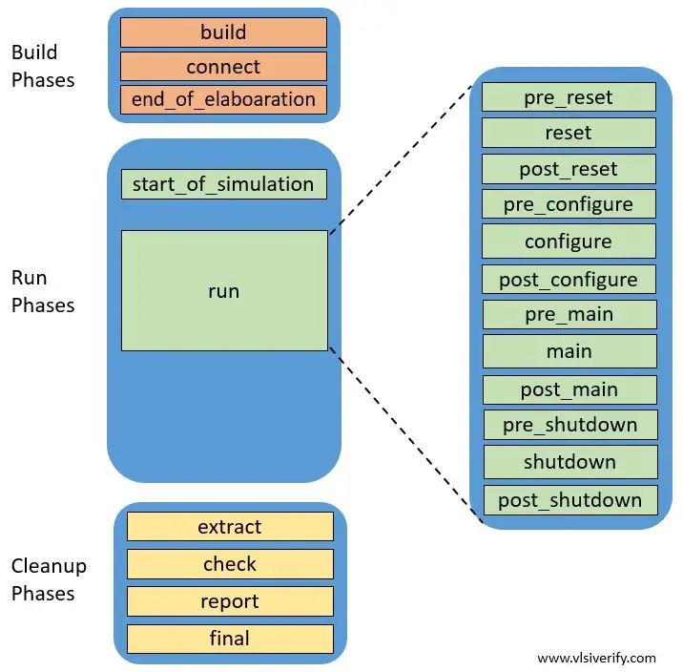
UVM Component Phasing

Slide 23
UVM Component Phasing: Build Phase
Phases in this category are executed at the start of the UVM testbench simulation, where the testbench components are
constructed,
configured and
connected.
All the build phase methods and functions are executed in zero simulation time.

Slide 24
UVM Component Phasing: Run-time phase
Once testbench components are created and connected in the testbench, it goes to the run phase where actual simulation time is consumed.
The run_phase for all components are executed in parallel.
The run_phase and pre_reset phase both start at the same time.

Slide 25
UVM Component Phasing: Clean-up Phase
The clean-up phase is used to collect information from
functional coverage monitors and
scoreboards
It checks whether the coverage goal has been reached or the test case has passed.
The cleanup phases will start once the run phases are completed.
It is implemented as functions and works from the bottom to the top of the component hierarchy.
Analysis components may use the extract, check, and report phase.

Slide 26
UVM Reporting

Slide 27
UVM Reporting
UVM Reporting or Messaging has a rich set of message-display commands & methods to alter the numbers & types of messages that are displayed without re-compilation of the design.
UVM Reporting has the concepts of
Severity,
Verbosity and
Simulation handling behavior.
Each reporting method can be independently specified and controlled.

Slide 28
UVM Reporting
Severity
Severity indicates importance
Examples are Fatal, Error, Warning & Info
Verbosity
Verbosity indicates filter level
Examples are None, Low, Medium, High, Full & Debug
Simulation Handling Behavior
Simulation handling behavior controls simulator behavior
Simulation Handling Behavior is the Action taken by the Simulator which is dependent from the Severity being produced by the Verification Environment.
Examples are Exit, Count, Display, Log, Call Hook & No Action

Slide 29
UVM Reporting
UVM Reporting provides Macros to embed report messages.
The following Macros can be used:
`uvm_info(string ID, string MSG, verbosity);
`uvm_error(string ID, string MSG);
`uvm_warning(string ID, string MSG);
`uvm_fatal(string ID, string MSG);
Simulator Action | Description
uvm_exit | Exit from simulation immediately
uvm_count | Increment global error count
uvm_display | Display message on console
uvm_log | Captures messages in a named file
uvm_call_back | Calls callback method
uvm_no_action | Do nothing
Severity | Simulator Action
uvm_fatal | uvm_display & uvm_exit
uvm_error | uvm_display & uvm_count
uvm_warning | uvm_display
uvm_info | uvm_display

Slide 30
UVM Objections

Slide 31
UVM Objections
The uvm_objection class provides a mechanism to coordinate status information between two or more components, objects.
The uvm_objection class is extended from uvm_report_object.
The objection deals with the concept of raise and drop objection which means the internal counter is increment and decrement respectively.
Each participating component and object may raise or drop objections asynchronously.
The objection has to be raised before starting any process and drop it once it is completed.

Slide 32
Managing Objections
The UVM phasing mechanism uses objections to coordinate with each other and the phase should be ended when all objections are dropped. They can be used in all UVM phases.
It allows proceeding for the “End of test”.
The simulation time-consuming activity happens in the run phase.
If all objections dropped for run phases, it means simulation activity is completed.
The test can be ended after executing clean up phases.

Slide 33
Managing Objections
task reset_phase( uvm_phase phase);
phase.raise_objection(this);
...
phase.drop_objection(this);
endtask
task run_phase(uvm_phase phase);
phase.raise_objection(this, "Raised Objection");
...
phase.drop_objection(this, "Dropped Objection");
endtask

Slide 34
Lab Task

